Slide 1
Premium Status Prediction Modelling
ZURICH INSURANCE
Modeling the prediction of Premium Status which it focus on Lapse and Surrender
categories for better claim reserving calculation
Notes:
Hi , This is the presentation of prediction modelling for Premium Status in Zurich Insurance Data.
My Name is Aryanto, and here is my profile.

Slide 2


Author :
Aryanto, M.Si
Hi There.
I am a Data Scientist with strong math and statistics background, Master in actuarial science with 4 actuary certification’s exam passed and 6+ years of experience using predictive-analytic modeling, machine learning algorithms, and configure them to understand data patterns and effectively connect the data, also provide business insights.
Full Time Profession
Electric-Vine Industries, role as Data Analyst for 2 years.
PT. Anekatek Consultants, role as Data Engineer for 2 years.
Amtrust Mobile Solution Indonesia, role as Operation Data Analyst for a year.
PT. LAPI ITB, role as Quantitative Risk Analyst for 4 months.
Part Time Profession :
Working as Data Science Freelencer on Upwork.com for more than 6 years.
Notes:
As in the Text

Slide 3
Instruction of Test Case
What should I Do?
This is the Instruction to create predictive modelling of Premium Status especially Lapse and Surrender categories.
Use Data Visualization
to visualize the data and generate some insight. Make as creative and as presentable as possible.
Do Predictive Modelling
For Premium Status, interested to predict Premium Status to Lapse and Surrender
This is the next process of the recruitment process for Zurich. We have prepared you sample data in R, please :
Additional Value
Create some interface app for user to use the predictive modelling.
Report and Presentation
Create PDF report and/or presentation to communicate the result to user
Notes:
As in the text

Slide 4








Try to figure out roadmap to user
Data Processing Roadmap
Data Preparation
Data Visualization
Data Wrangling
Feature
Engineering
Data Modelling
This step contains some substeps such as :
Module Preparation : Installation or loading packages
Querying (if needed) or converted data type
Load data into Memory
Data Describing
To Visualized data, we try to provide :
Bar Chart for Categorical Data
Pie Chart for Discrete Data
Density and Histogram for Continuous Data
We did concept of hierarchical indexing :
Working with missing value
Correcting data attribute especially in categorical data
Working with date type
Dropping categorical and date features
To engineering numerical representation of raw data :
Transform any data type into appropriate numerical
Look deep into features about causal effect to target
Especially for Continuous Data case, dropping feature is needed
We try to predict target by :
Divided dataframe into several group, as feature training, feature test, target training, and target test.
Using several ML Supervised Algorithms
Model Evaluation
Export the prediction
Notes:
For some reasons, I did not complete the feature engineering section. I mean the feature engineering has a main step, it is feature selection. After the day of task deadline, I tried to determine the features which it appropriates to be included in the machine learning algorithm. I got 12 of 18 Features which included into next analysis.

Slide 5
Understanding the Data and Examining Data Set
DATA PREPARATION

Slide 6
Understanding the Data and Examining Data Set
Data Preparation Steps
Load Python Modules
Describing Data
We use several modules :
For data Analysis and Wrangling : pandas, numpy, and datetime
Data Visualization : matplotlib, seaborn and scipy
Machine learning : sklean
Some pre-step to do analysis and prediction here.
Converting .rds data type into .csv data type
Loaded Data into memory as dataset
Show sample of data
Put statistics description
Check missing data
Table Explanation
Target Filtering
It was purposed to show meaning of columns attributes.
We got this information from Zurich User for help to understand the data
We’ll get target with its feature from data.
It’s clearly that our target is ‘Lapse’ and ‘Surrender’ inside of Premium Status attribute. We extract those categories into another dataset.

Slide 7
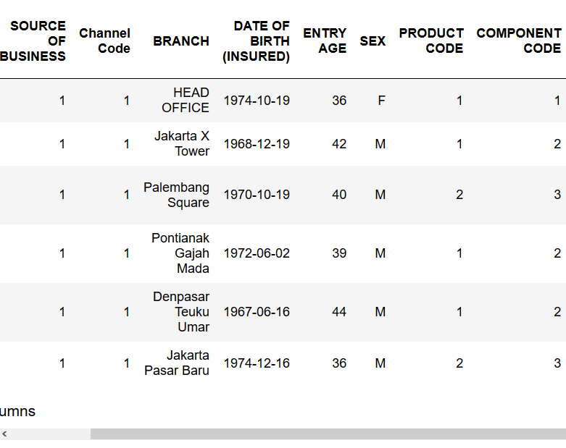
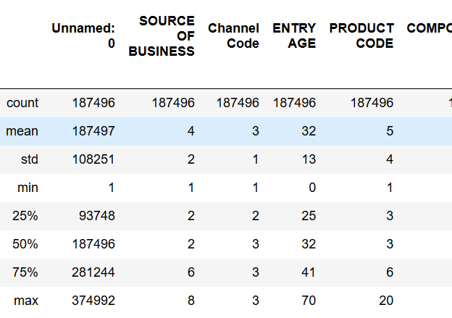
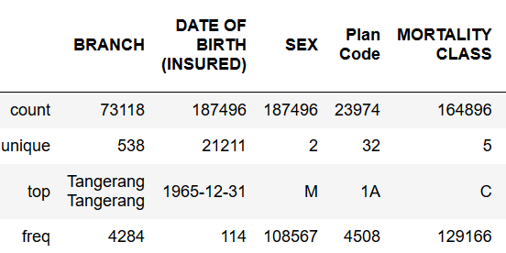
Data Preparation Step
Data Set Describing
Data Exploration
Since this is an entirely new insurance dataset that we've never seen before, the first goal here is to understand the data. We have already seen the textual description of the data, which is important for qualitative understanding. We compute also a quantitative description.
We have show Sample of Data
We have quantitative statistics description for Continuous and Discrete Data
We have quantitative statistics description for Category, Date, and Alphanumeric Data type

Slide 8
Data Preparation Step
Dataset : Missing Value
PLAN CODE
87 %
SMOKER Indicator
75 %
Top 4 with average more than 20% NULL
BRANCH
An important part after loading data for analysis is ensuring that it's clean. We would generally need to deal with missing data and ensure that all columns have the correct datatypes. Beside this paragraph, you will see the percentage of missing data before Premium Status filtering. They will change only a little percentage after filtering.
61 %
NLG STATUS
29 %
1.4 %
3.8 %
12.1%
Premium Due Date
Address
Mortality Class

Slide 9

Data Preparation Step
Target Filtering
LA | 98,865 | Lapse
PP | 57,442 | Premium Paying
SU | 20,233 | Surrender
HA | 4,923 | Premium Holiday
SP | 3,413 | Single Premium
FL | 1,802 | Free Look
S | 513 | -
EX | 135 | Expired
CO | 100 | Cancel Overdue
PW | 36 | Premium Waiver
CF | 34 | Cancel since Inception (without charge)
83%
Premium Status
17%
LA
SU
As we mention before, our target is Premium Status with interest on Lapse and Surrender categories. For now, the raw data is still on categorical type.
187,496 Rows
119,098 Rows
Before filtering process
After filtering process

Slide 10
Visualized data into graphic to extract better understanding
DATA VISUALIZATION

Slide 11
Data Visualization Step
Chart of Mortality Class
Mortality Class says about occupation scope classification
It’s interesting when we talk about occupation related with gender. Since somehow in Indonesia, there are discriminant for gender, it became potential causal effect for Lapse and Surrender in insurance portfolio. There is a big number for Class C in the Mortality Class, since it may lower-middle class occupations
57 %
43 %
Male User
Female User
Gender in Mortality Class type C

Slide 12
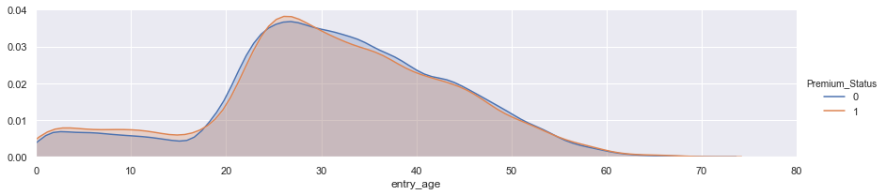
Data Visualization Step
Giant Missing Data
Smoker Indicator and Others Graph
3.4%
34.2%
62.1%
Channel 1
Channel 2
Channel 3
Channel Code
Great Missing Value will eliminate potential causal effect features
Smoker
To think have good causal effect feature e.g. smoker and non-smoker in insurance portfolio, it fall through many missing value. We could not try to guessing by binomial distribution, because it will affect our model.
Non Smoker
73%
Density for Entry Age, divided by Lapse and Surrender
16%
11%

Slide 13
the process of cleaning and unifying messy and complex data sets for easy access and analysis
DATA WRANGLING

Slide 14
Data Wrangling Step
Data Cleansing
Time Consumption
Cleansing Data
Categorical data cleansing and mistype repair, if any
Dropped features which have more than 20% missing value
Filled missing value with its median or mode
Fixed the feature’s names
We did some pivoting to better understanding in data contained.
We do data cleaning and it’s Boring
75%
Dealing with Date data type
The process of transforming and mapping data from one raw data form into another format with the intent of making it more appropriate and valuable for a variety of downstream purposes such as analytics.
Convert into date string into datetime type
We only get the years only
Some of feature with same median, Quantile 75th, and/or mean, will dropped also.
Possible Irrelevant Features
We got some irrelevant features which show in data
We decided to drop all of them

Slide 15
the process of using domain knowledge of the data to create features that make ML algorithms work
FEATURE ENGINEERING

Slide 16
Feature Engineering
Feature Mapping
Mapping the Target : “LA” to 0 and “SU” to 1
Process to Feature Engineering
Features Selection
Another of the common feature engineering methods is bringing the data into a given interval or simply map to numeric. Why would we do it?
Trivial as computations on a bounded range of numbers prevent some numerical inaccuracies and limit the computational power required.
Some machine learning algorithms can handle that data better when it is normalized. There are several approaches to scaling of the data. In this working, we didn’t.
Another way by using basic statistics transformation methods, e.g. square root, logarithm, etc.
Mapping all categorical features, and for categorical which have more than 8 items, will be simplify in group
Scaling
Mapping years as date type into interval group
Transformation
Mapping Discrete data type into several numeric group, and continuous data into interval group
Interval Mapping

Slide 17
Feature Engineering
Feature Selections
Principal component
analysis
It took addition time to implement in our data
Recursive Feature
Elimination
Otherwise, we have done manual selections by its median, mean, and Quantile 75th
It better to implement feature selection before rescaled data and transformation were done
Univariate Selection
Manual
We did feature Selections after report back
By using univariate selection with chi square distribution compare with RFE method, there are unstable result we got. We mean, some features are selected by univariate but it did not selected by RFE for k = 10. Such as annualized_standard_premium. In PCA, the algorithm said it’s enough 3 features to be modelled.. Anyway, RFE and Univariate Selection is easy to understand and interpretable.

Slide 18
to train, tune, and validate a machine learning model
DATA MODELLING

Slide 19
Data Modelling
Modelling : Machine Learning Result
83.6
85.0
81.4
88.9
88.9
84.7
Logistic Regression
K-Nearest Neighbors
Naïve Bayes Classifier
Decision Tree
Random Forest
Support Vector Machines
Variance 0.024 and Biased 0.372, easy to interpreting
Variance 0.094 and Biased 0.298
Variance 0.048 and Biased 0.368
Variance 0.069 and Biased 0.308
Variance 0.064 and Biased 0.309
Variance 0.024 and Biased 0.359, hard to use and difficult interpret
We choose prediction from Random forest modelling. While both Decision Tree and Random Forest score likely same, we choose to use Random Forest as they correct for Decision Tree's habit of overfitting to their training set

Slide 20
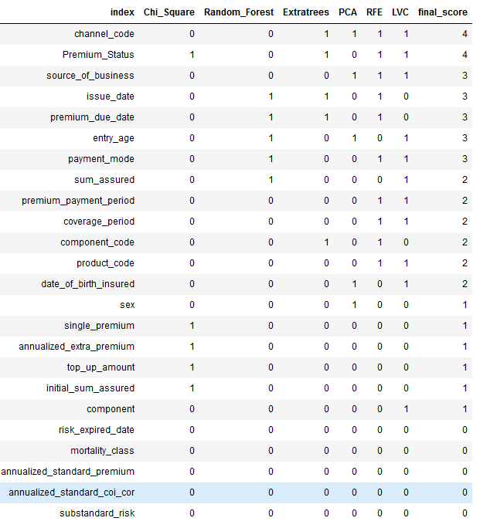
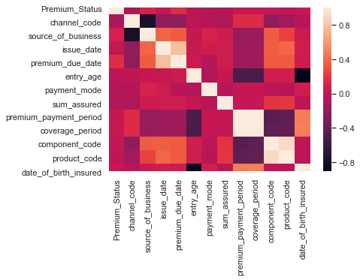
Data Modelling
Changing the Features and getting New Result
We tried to search again the best features to be included into ML Algorithm, and we got :
12 Features from 18 last Features
Notes:
Issue date and premium_due date are closely correlated, premium_payment_period and coverage_period are closely correlated, and component_code and product_code are closely correlated also.
We vote each the feture using 6 feature selection methods :
Univariate selection using chi squares
LVC feature selection (Linear Support Vector Machine)
Recursive Feature Elimination
Feature Importance using Random Forest
Feature Importance using Extratrees Classifier
Principle Component Analysis (PCA)

Slide 21
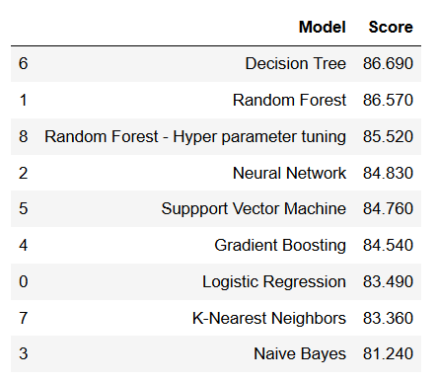
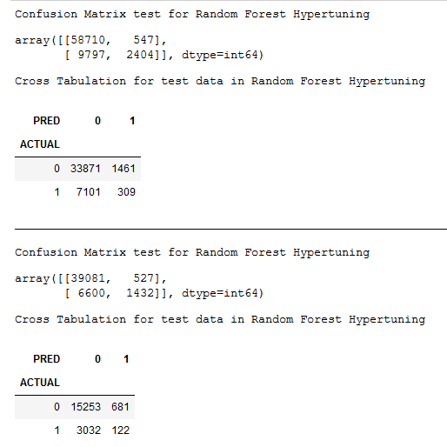
Data Modelling
The Final Prediction Modelling
We choose : Random Forest Hyper-Parametric Tuning
Notes:
We choose Random Forest Hyper-Parametric Tuning as the final prediction modelling for Lapse and Surrender Categories in Premium Status based on Robustness principle.

Slide 22
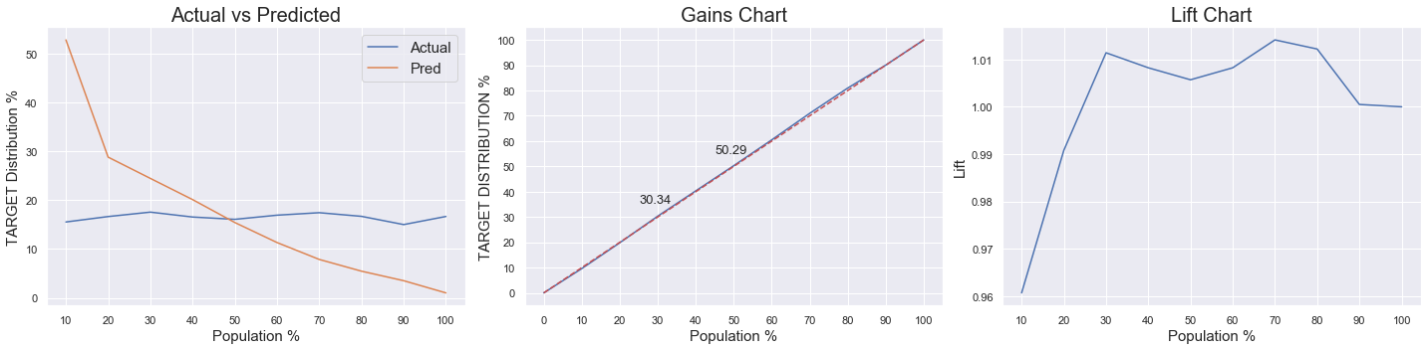
Data Modelling
The Chart of Prediction Modelling
Notes:
Lift Chart = A measure of the effectiveness of a predictive model calculated as the ratio between the results obtained with and without the predictive model.
Gain and Lift charts are used to evaluate performance of classification model. So, these charts were purposed Measuring the Performance of prediction result.
We want to understand what benefit the predictive model can offer in predicting which the prediction value will be actual value versus non-actual value in a new campaign (compared to targeting them at random). This can be achieved by examining the cumulative gains and lift associated with the model, comparing its performance in targeting actual value with how successful we would be without the added value offered by the model.
In this context, Population means Percentile.

Slide 23
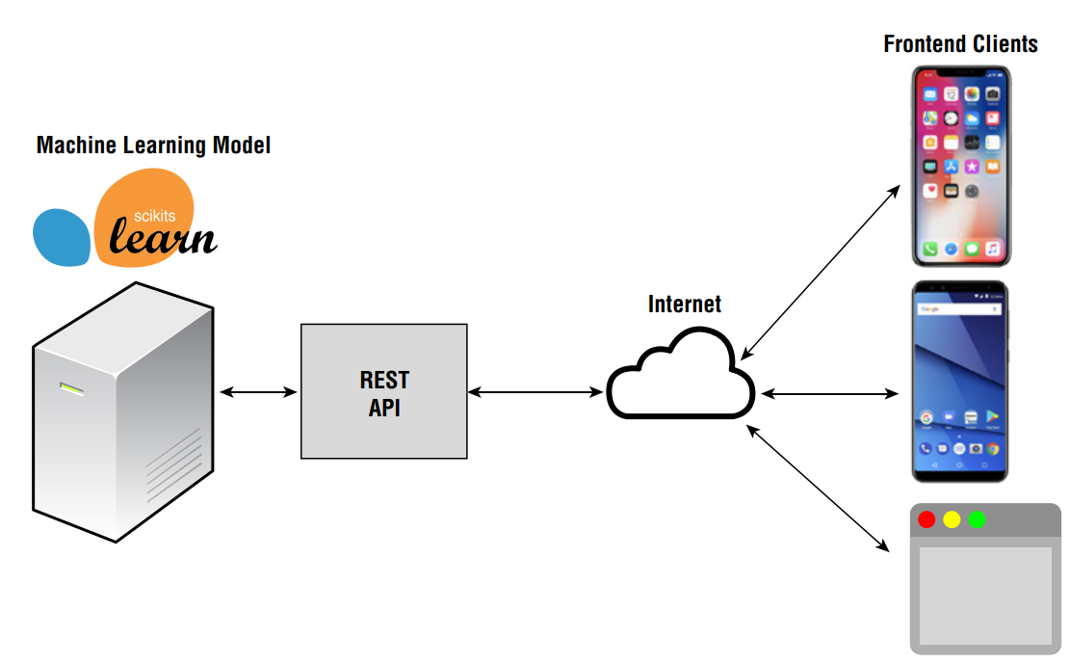
Data Modelling
Deploying Machine Learning Models
The main goal of machine learning is to create a model that we can use for making predictions.
A good way to deploy our machine learning model is to build a REST (RE-presentational State Transfer) API
The result can then be returned back to the application. Summarizes the architecture that we will use for deploying our machine learning model.
Notes:
The main goal of machine learning is to create a model that we can use for making predictions. At the end of the entire process, what we really want is to make our model accessible to users so that they can utilize it to do useful tasks, like making predictions (such as helping doctors with their diagnosis, and so forth). A good way to deploy our machine learning model is to build a REST (RE-presentational State Transfer) API, so that the model is accessible by others who may not be familiar with how machine learning works. Using REST, we can build multi-platform front-end applications (such as iOS, Android, Windows, and so forth) and pass the data to the model for processing. The result can then be returned back to the application. Summarizes the architecture that we will use for deploying our machine learning model. In python we could use Flask as the main framework. Setting and you got url (in here just localhost:5000 or 127.0.0.1:5000) For the client application, Python client is pretty straightforward—formulate the JSON string to send to the service, get the result back in JSON

Slide 24
The End of Presentation
Thank you for your time
Data is part of our life and we can predict our futures.

